Slide 1


Case Study 3: Energy Efficiency in Smart Buildings

Slide 2
TEAM
G. Kaviya (TEAM LEADER S4F_CP_Team_14517 )
C.Saranya (TEAM MEMBER S4F_CP_Team_14517)
G.Nima (TEAM MEMBER S4F_CP_Team_14517 )
V.Deepa (TEAM MEMBER S4F_CP_Team_14517 )
S.Sahana Parveen (TEAM MEMBER S4F_CP_Team_14517 )

Slide 3
Content
Abstract
Problem Statement
Objective
Data Collection and Preparation
Proposed Solution (Methodology)
Model Performance Evaluation
Screenshots / Demonstration (video)
Future Scope
Conclusion
Notes:
Abstract
Problem Statement (Clearly define the challenge)
Objective (State your project's goal)
Background and Research (Discuss existing solutions, trends, and gaps)
Data Collection and Preparation (Focus on data sources, cleaning, and augmentation)
Proposed Solution (Methodology)
Model Architecture (e.g., CNN, U-Net, YOLOv5)
Key Techniques (e.g., Transfer Learning, Image Augmentation)
Model Performance Evaluation
Metrics (Accuracy, Precision, Recall, IoU, etc.)
Graphs (Confusion Matrix, ROC Curve, etc.)
Screenshots / Demonstration (Visual proof of system functionality)
Future Scope (Improvements, scalability, and integration ideas)
Conclusion (Summarize results and impact)
Q&A Session

Slide 4
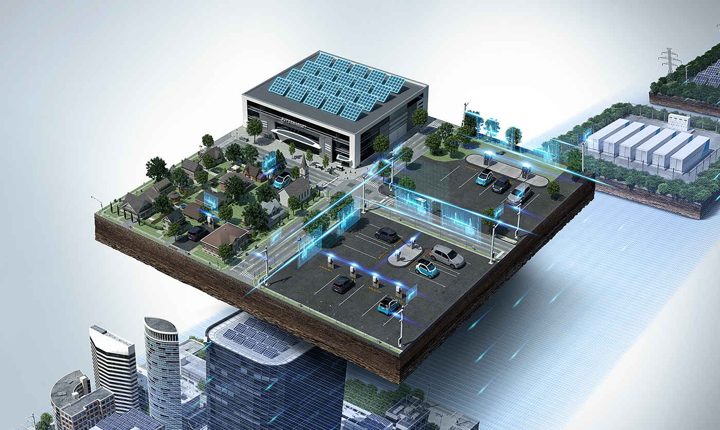
Abstract
Buildings account for nearly 40% of global energy consumption, making energy efficiency a key area for sustainable development.
This project explores an AI-powered energy management system that predicts and optimizes energy consumption based on occupancy and weather data.
Using machine learning, we analyze historical energy usage, identify inefficiencies, and provide actionable insights to reduce consumption while maintaining occupant comfort.

Slide 5

Problem Statement
Commercial buildings have high energy demands due to HVAC (Heating, Ventilation, and Air Conditioning) systems.
Inefficient energy use leads to increased costs and environmental impact.
The challenge is to develop a predictive model that accurately forecasts energy consumption and suggests optimizations to improve efficiency.

Slide 6
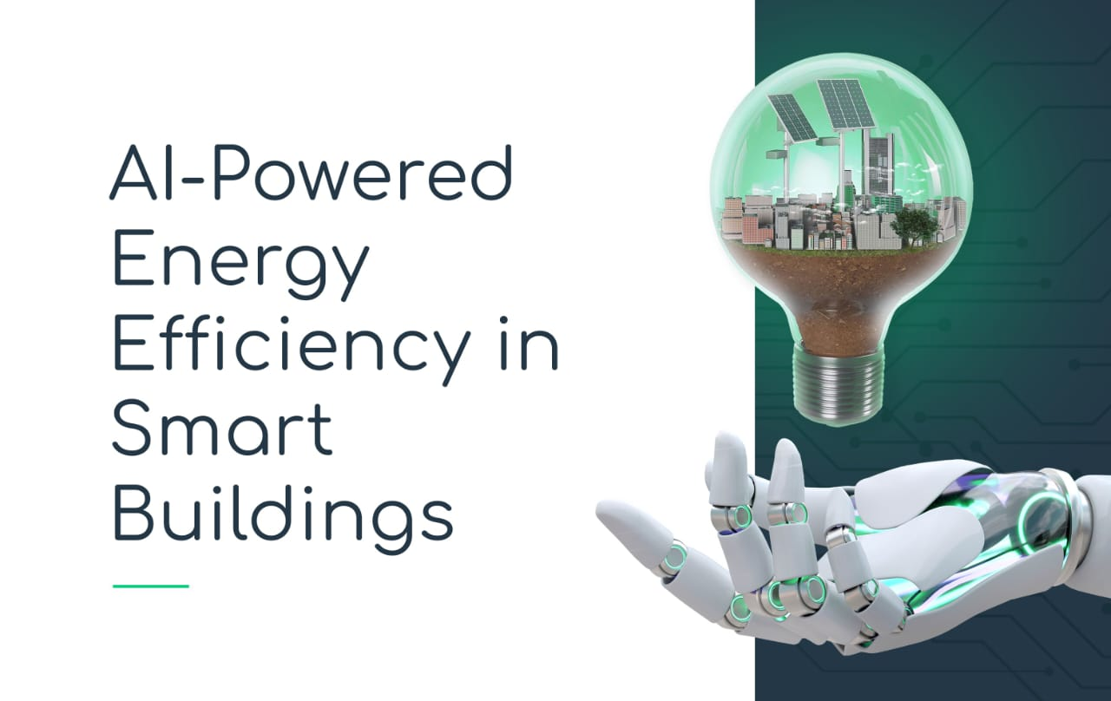
Objective
Develop a machine learning model to predict energy consumption based on occupancy and environmental factors.
Identify key factors influencing energy usage.
Provide actionable insights to optimize HVAC operations and reduce energy waste.
Evaluate model performance to ensure accuracy and reliability.

Slide 7

Data Collection and Preparation
Dataset Used:
The dataset includes:
Energy consumption data: Historical readings over two years.
Occupancy data: Number of people present in the building at different times.
Weather conditions: Temperature, humidity, and wind speed.
Preprocessing Steps:
Handling missing values and data inconsistencies.
Converting time-series data into structured formats.
Feature engineering (e.g., creating new features like weekdays/weekends).
Splitting data into training and testing sets.

Slide 8
Proposed Solution (Methodology)
Data Analysis:
Visualizing trends in energy consumption and occupancy.
Identifying correlations between weather and energy usage.
Machine Learning Model:
Algorithm Used: Random Forest Regressor (best suited for energy prediction).
Training Process:
Input: Occupancy, temperature, humidity, wind speed, time of day.
Output: Predicted energy consumption.
Hyper parameter Tuning: Optimized for better accuracy.
Evaluation Metrics:
Mean Absolute Error (MAE): Measures average prediction error.
Root Mean Square Error (RMSE): Evaluates prediction deviations.
R² Score: Assesses model accuracy.

Slide 9
Model Performance Evaluation
Metric | Score
MAE | ~3.5 kWh
RMSE | ~5.2 kWh
R² Score | 0.92 (high accuracy)
The results show a strong correlation between actual and
predicted values, proving the model’s reliability.

Slide 10
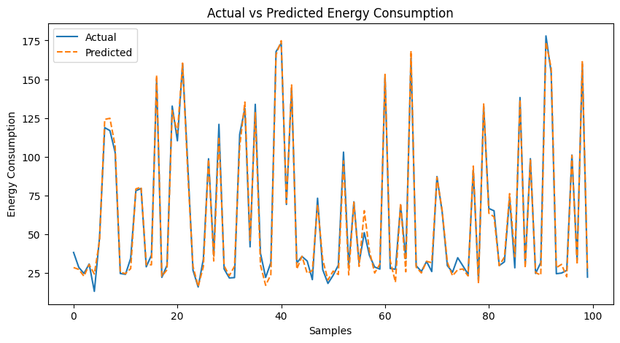
Screenshots / Demonstration (video)
GITHUB LINK: https://github.com/Kaviya0925/CASE_STUDY-3_S4F_CP_Team_14517

Slide 11

Future Scope
Integration with IoT Sensors: Real-time monitoring and automation of HVAC systems.
Renewable Energy Optimization: AI can help balance energy consumption with solar or wind power.
Expansion to Smart Cities: Implementing AI models in multiple buildings for large-scale energy savings.
Incorporating More Features: Adding occupancy patterns, appliance usage, and external factors like pollution levels.

Slide 12

CASE STUDY-3
QUESTIONS & ANSWERS

Slide 13
1. How can AI be used to identify inefficiencies in energy consumption in smart buildings?
AI analyzes historical energy data, identifies patterns, and detects anomalies. By using machine learning models, AI can:
Predict future energy usage based on occupancy and weather conditions.
Identify periods of excessive energy consumption.
Recommend energy-saving measures, such as adjusting HVAC settings based on occupancy patterns.
Detect faulty appliances or inefficient systems consuming excess energy.

Slide 14
2. Build a model to predict the energy consumption of the building based on occupancy and weather data.
Steps to build the model:
Data Collection: Gather energy consumption, occupancy, temperature, humidity, wind speed, and time-related features.
Data Preprocessing:
Handle missing values.
Convert categorical features (e.g., time of day, day of the week) into numerical data.
Normalize numerical features for better model performance.
Feature Selection: Identify important variables (occupancy, temperature, humidity, etc.).
Train a Machine Learning Model:
Algorithm: *Random Forest Regressor* (performs well on time-series data).
Train using 80% of data, test on 20%.
Evaluate Performance: Use *MAE, RMSE, and R² score* to measure accuracy.
Deploy the Model: Integrate with a dashboard for real-time predictions.

Slide 15
3. Suggest additional features that could be incorporated into the model to improve its accuracy.
To improve prediction accuracy, consider adding:
CO₂ Levels: Higher CO₂ might indicate more people, affecting energy use.
Appliance Usage: Track power consumption of HVAC, lighting, and equipment.
Solar Energy Availability: Optimize energy use based on renewable generation.
Building Insulation Data: Better-insulated buildings consume less energy.
Historical Peak Usage: Identify seasonal variations in energy demand.
Occupancy Patterns: Predictive schedules for regular building usage.
Electricity Tariffs: Adjust energy consumption based on peak and off-peak pricing.

Slide 16
4. What steps can building managers take based on the model's predictions to reduce energy consumption?
Optimize HVAC Scheduling: Adjust heating/cooling based on occupancy trends.
Smart Lighting Control: Turn off or dim lights when rooms are unoccupied.
Automate Energy Management: Use AI-driven systems to adjust power consumption in real-time.
Identify and Replace Inefficient Equipment: Detect faulty or energy-intensive devices.
Implement Peak Load Shifting: Shift energy-intensive operations to off-peak hours.
Encourage Energy-Saving Behavior: Provide insights to occupants on energy usage patterns.

Slide 17
5. How can AI-driven solutions contribute to achieving net-zero energy buildings?
AI plays a crucial role in “Net-Zero Energy Buildings (NZEBs)” by:
Optimizing Energy Consumption: AI ensures minimal energy wastage by automating heating, cooling, and lighting.
Integrating Renewable Energy: Predicts energy demand and aligns it with solar/wind generation.
Demand Response Management: AI helps balance power grid loads by adjusting building energy usage during peak hours.
Energy Forecasting: Helps plan efficient energy storage and utilization.
Adaptive Controls: AI continuously learns from new data to improve efficiency over time.

Slide 18

Conclusion
This project demonstrates how AI and machine learning can be leveraged to predict and optimize energy consumption in buildings. By analyzing occupancy data and weather conditions, the proposed model effectively forecasts energy usage, helping building managers make informed decisions to reduce inefficiencies. The results show that AI-driven solutions can enhance energy efficiency, lower operational costs, and contribute to sustainability goals.
With further improvements, such as incorporating real-time IoT data and adaptive control mechanisms, this system can play a vital role in achieving *smart, energy-efficient, and net-zero buildings* in the future.

